Slide 1


HELPING MY CHILD …
… THROUGH TRANSITION
PRESENTER: Michele A. Meredith (PhD)
July 2023

Slide 2

Introduction
What is transition?
What is school-to-work transition?
How does STWT affect my child?
How does STWT affect me?
What do I need to know about STWT?

Slide 3

Seeing Beyond the Present
What can I expect for my child?
FUTURE

Slide 4
“I have had this desire my whole life to prove people wrong, to show them I could do things they didn’t think I could do.”
David A. Paterson

Slide 5


Slide 6
I have a Disability yes that’s true, but all that really means is I may have to take a slightly different path than you.”
Robert M. Hensel

Slide 7

Source: https://twitter.com/wheelierecord/status/577563454879494144
Notes:
Source https://twitter.com/wheelierecord/status/577563454879494144

Slide 8
“We are put in situations to build our character… not destroy us.” — Nick Vujicic

Slide 9
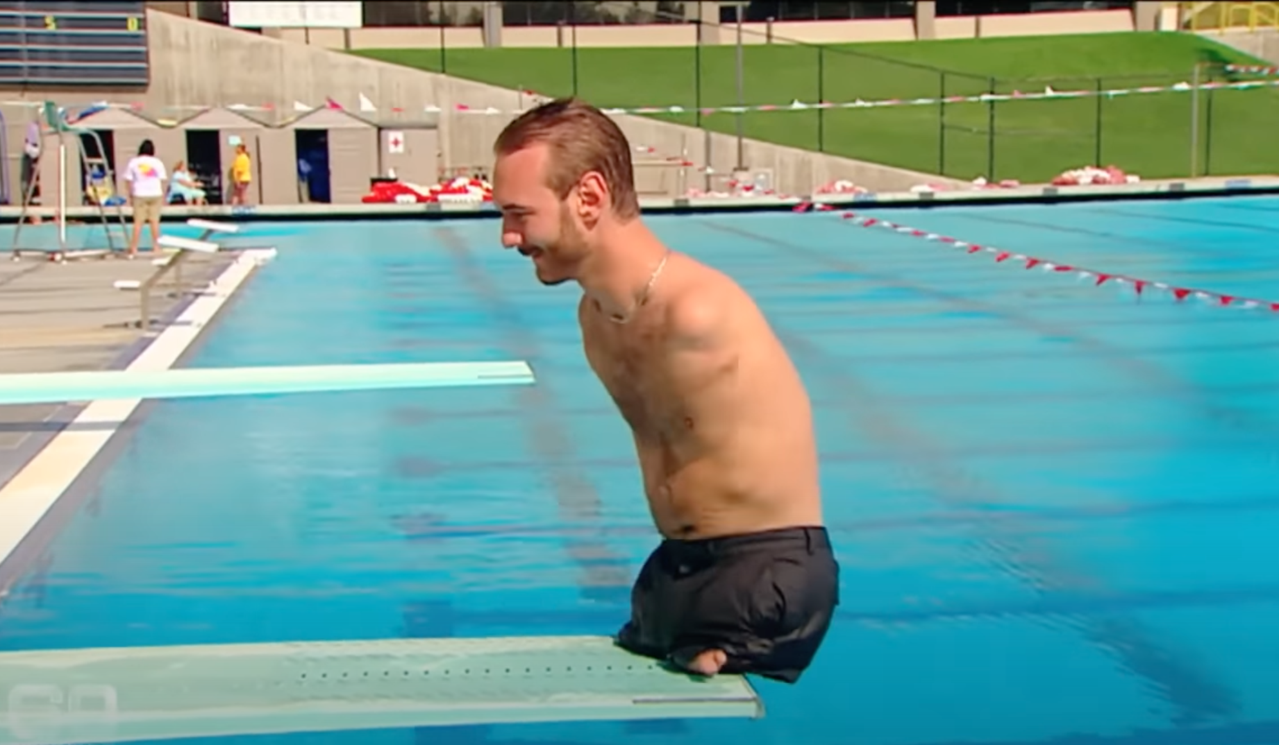

Slide 10


Slide 11
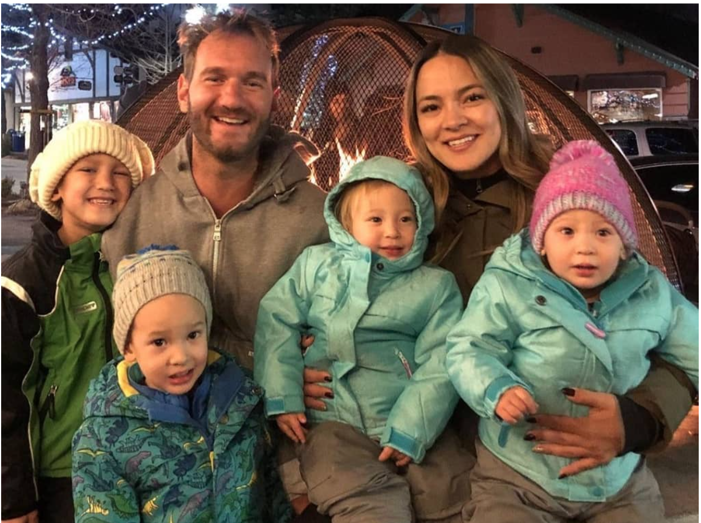

Slide 12
JAMAICAN ROLE MODELS

Slide 13

Dr. Christine Hendricks
Executive Director,
The Jamaica Council for Persons with Disabilities (2023)

Slide 14

Cecil Smythe (centre) and members of the
Portmore Self-Development Organization
Notes:
Source https://jamaica-gleaner.com/article/news/20170404/social-enterprise-success-story-making-jamaica-great-disabled

Slide 15

Senator Floyd Morris
Notes:
https://www.linkedin.com/in/floyd-morris-67496b71/?originalSubdomain=jm

Slide 16
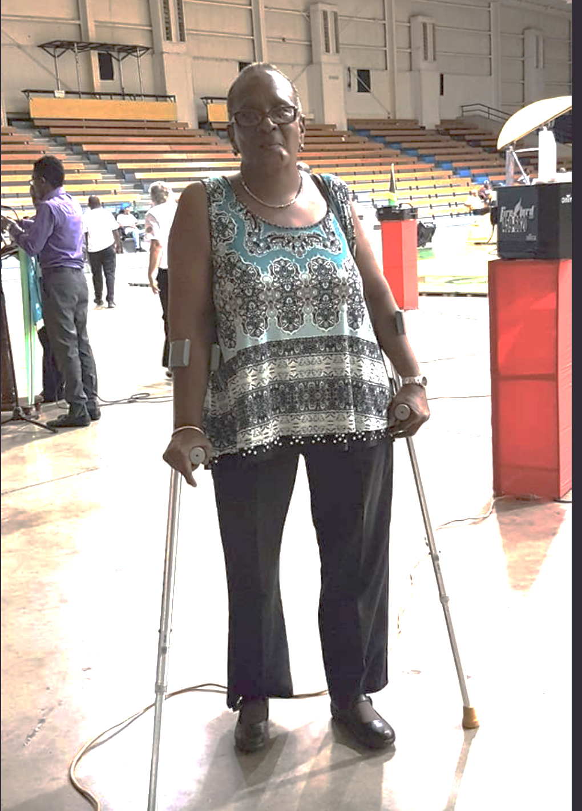
SARAH NEWLAND-MARTIN

Slide 17



Other examples of success
Notes:
https://www.specialolympics.org/stories/athletes/anything-is-possible-jamaican-athlete-touches-hearts-at-special-olympics-world-games
https://www.facebook.com/TeamJamaica876/posts/-sylvia-grant-of-team-jamaica-finished-10th-in-womens-discus-throw-f57-with-2312/3825289900905440/

Slide 18


Slide 19

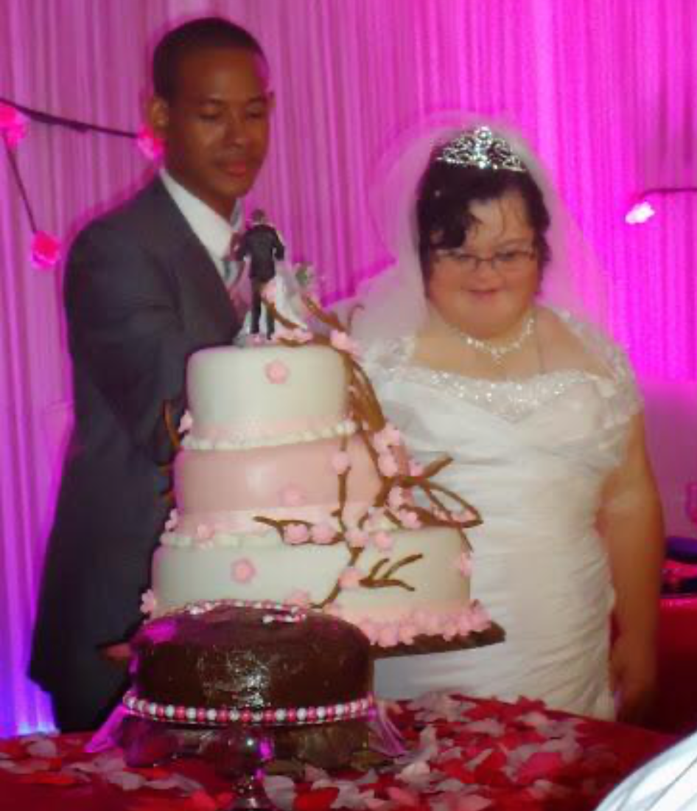

Slide 20

Chupse - Jamaica Association for Intellectual Disabilities
Notes:
https://www.facebook.com/photo.php?fbid=421465096701308&set=pb.100065134644961.-2207520000&type=3

Slide 21
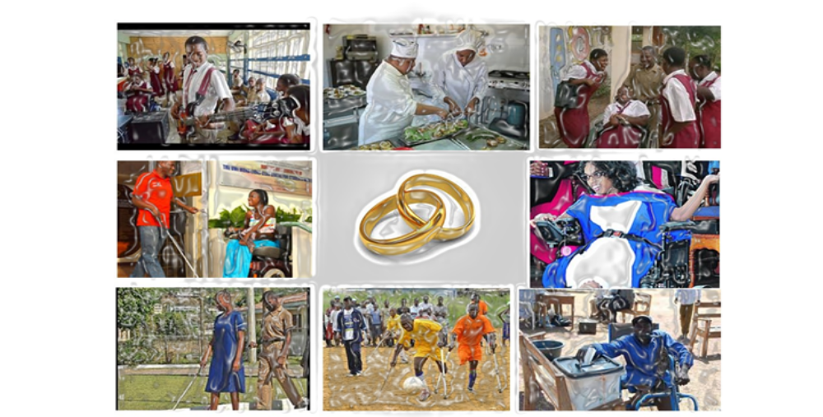

Slide 22
What is School-to-Work Transition?
The activities and programmes that prepare children and youth for life after school:
  Continued or higher education
  Vocational training
  Employment
  Personal relationship
  Leisure activities and social interests

Slide 23
What is STWT … really?
Phases
  Preparation for employment and other post-school activities
  Transitioning into employment and other post-school activities
  Transited into settled employment; and other post-school activities

Slide 24
What is STWT… really?
A coordinated set of activities for a student, designed within an outcome-oriented process, which promotes movement from school to post-school activities …’ (IDEA, 2004)
  STWT is person-centred, interest focused, and requires coordination among home, school, community and service agencies.

Slide 25

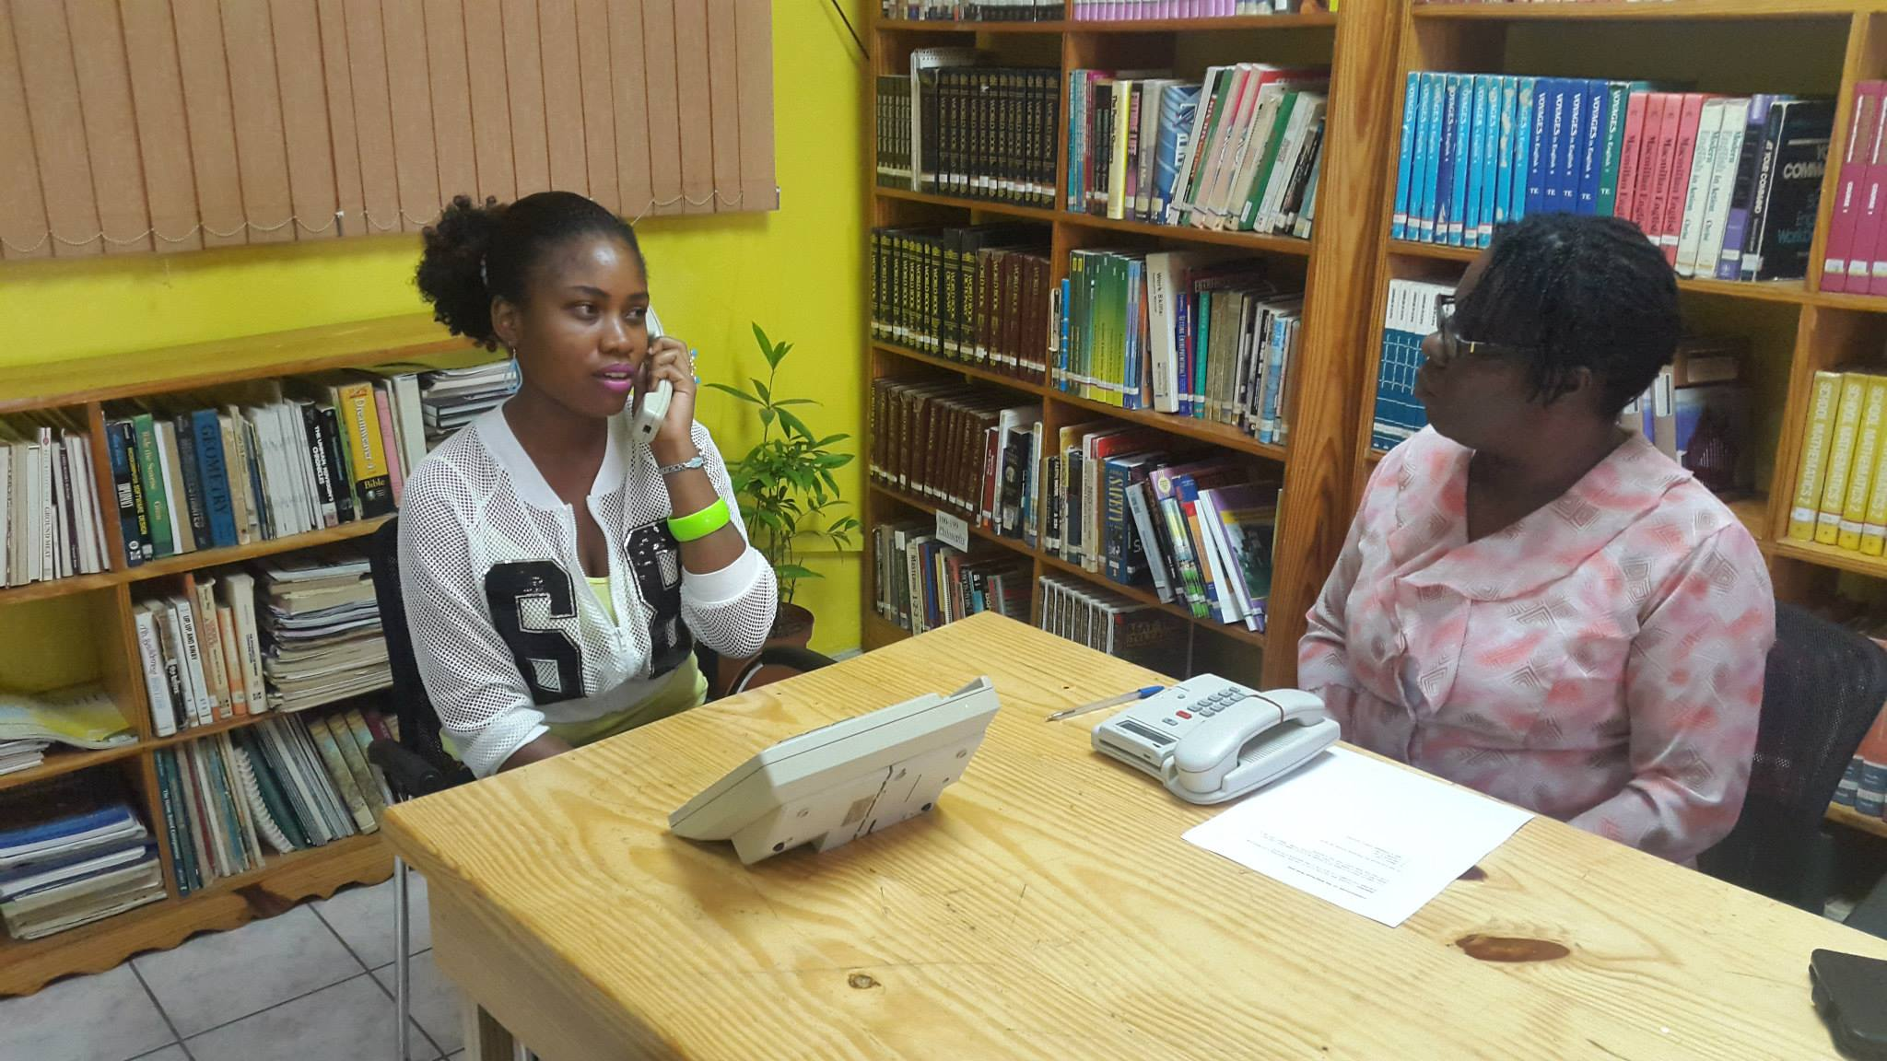
What is STWT … really?
Key points for STWT planning:
    career interest readiness
    career planning and development
    job preparation and work-experience

Slide 26
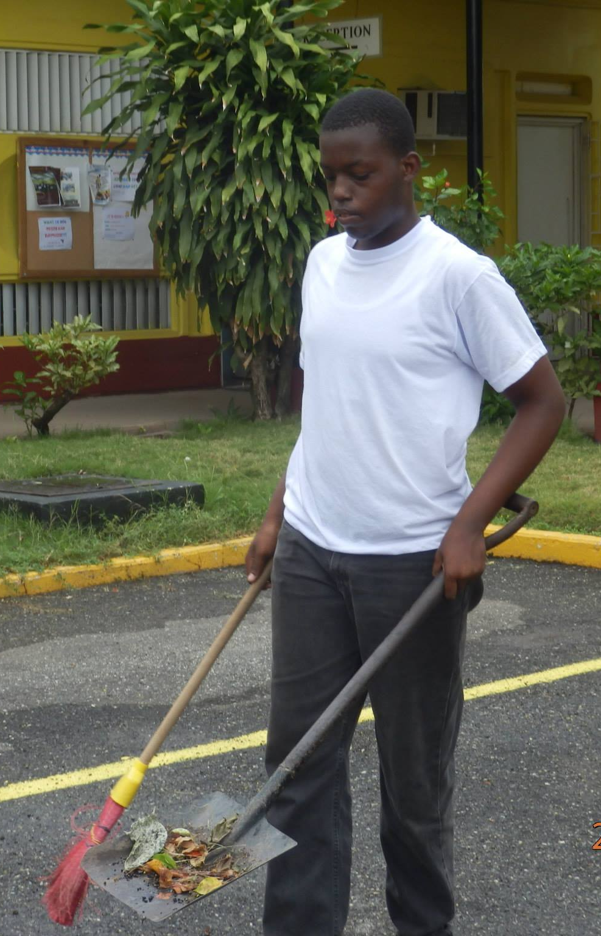
What is STWT … really?
Key points for STWT planning:
    post-secondary education
    leisure pursuits
    community integration, and
    independent living

Slide 27
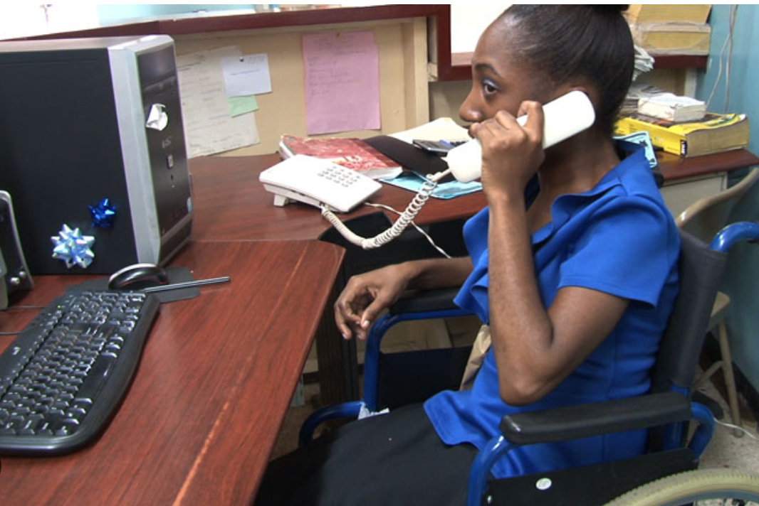
What is STWT … really?
Key points for STWT planning:
    post-secondary education
    leisure pursuits
    community integration, and
    independent living

Slide 28
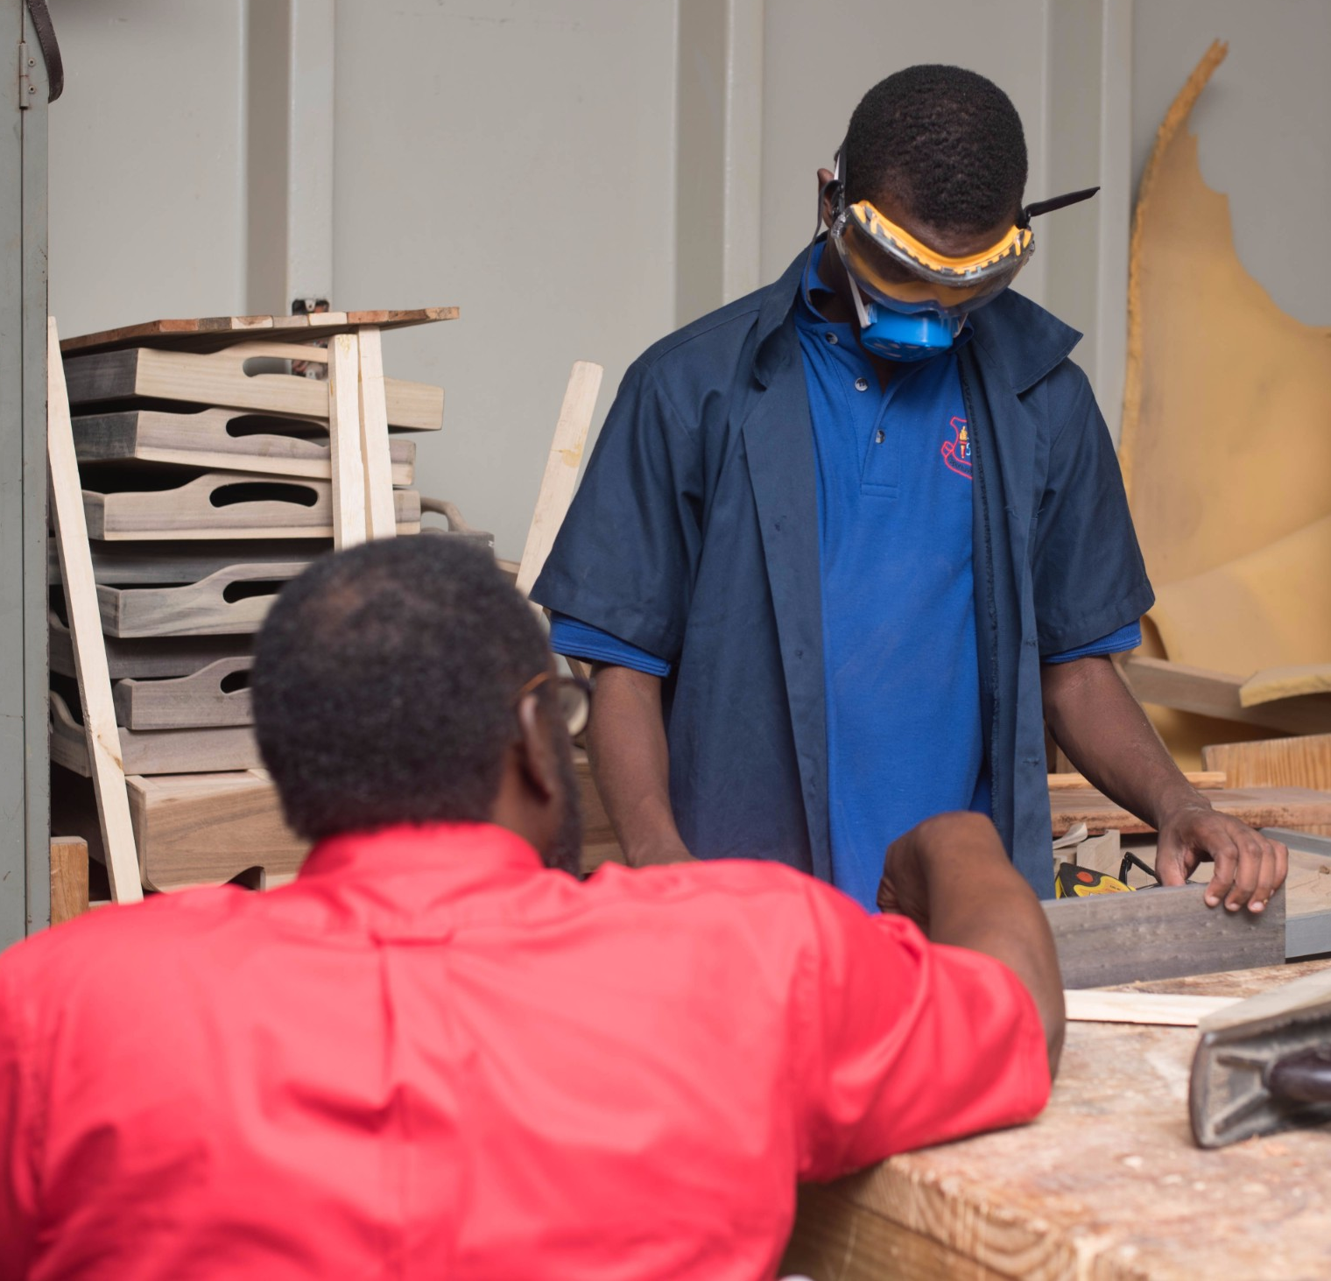
What is the Role of the School in Transition Preparation?
Provide a curriculum, activities, and programmes that steer children toward adult roles and responsibilities:
  Literacy and numeracy skills
  Communication and social skills
  Self-advocacy and self-determination skills
  Work experience and career interests and work
  Employment-readiness skills

Slide 29

What is the Role of the Parent in Transition Preparation?
Maintain positive and practical thoughts about your child’s interests and abilities
Provide practical guidance and support
Talk to them about their growth and adulthood
Help them discover areas of interests for success
Find examples of successful role models to share with them

Slide 30
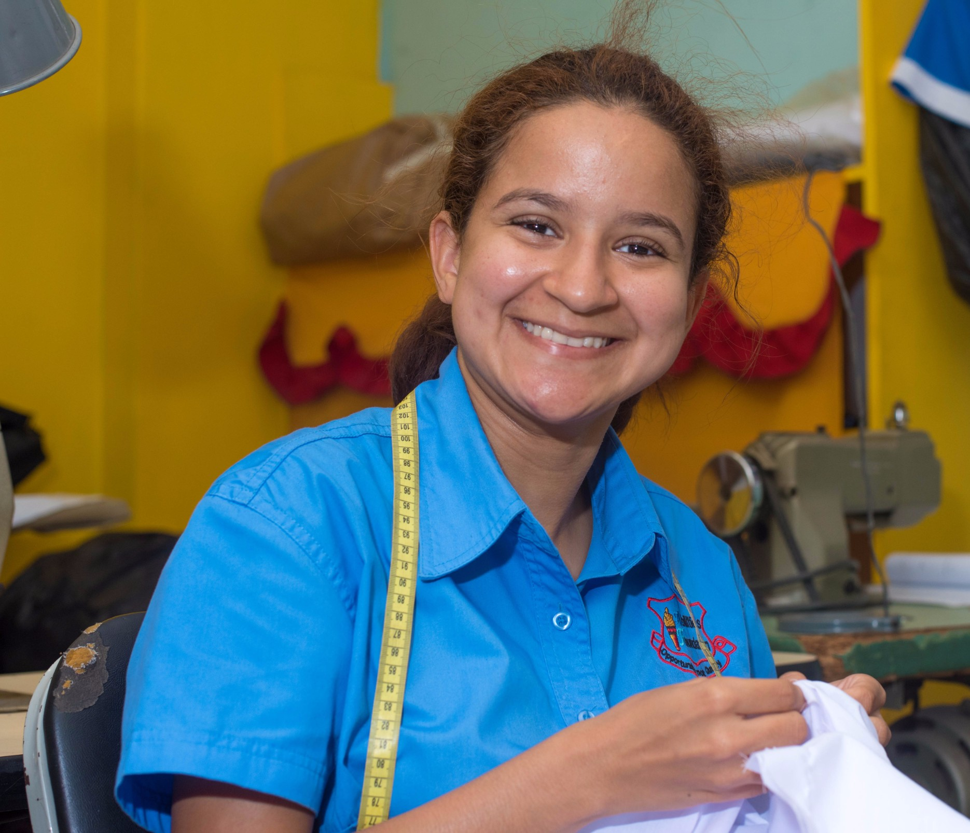
What is the Role of the Parent in Transition Preparation?
Share expectations for school outcomes with your child.
Observe growing skills, and model or teach skills at home to support what is taught at school.
Encourage and provide opportunity for social growth and interaction.
Encourage and provide opportunity for self-advocacy and independence.
Support your child’s hopes and dreams

Slide 31
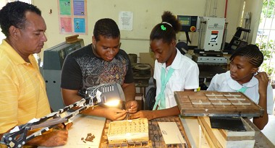
What is the Role of the Parent in Transition Preparation?
Listen to your child.
Dream with your child.
Encourage your child.
Encourage your child.

Slide 32
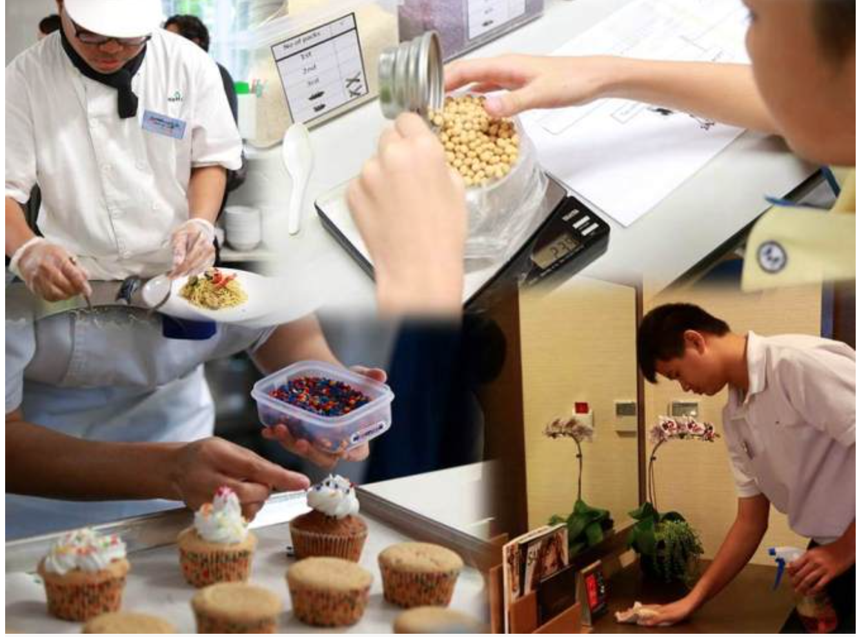
Big Idea!
There are possibilities for your young adult!

Slide 33
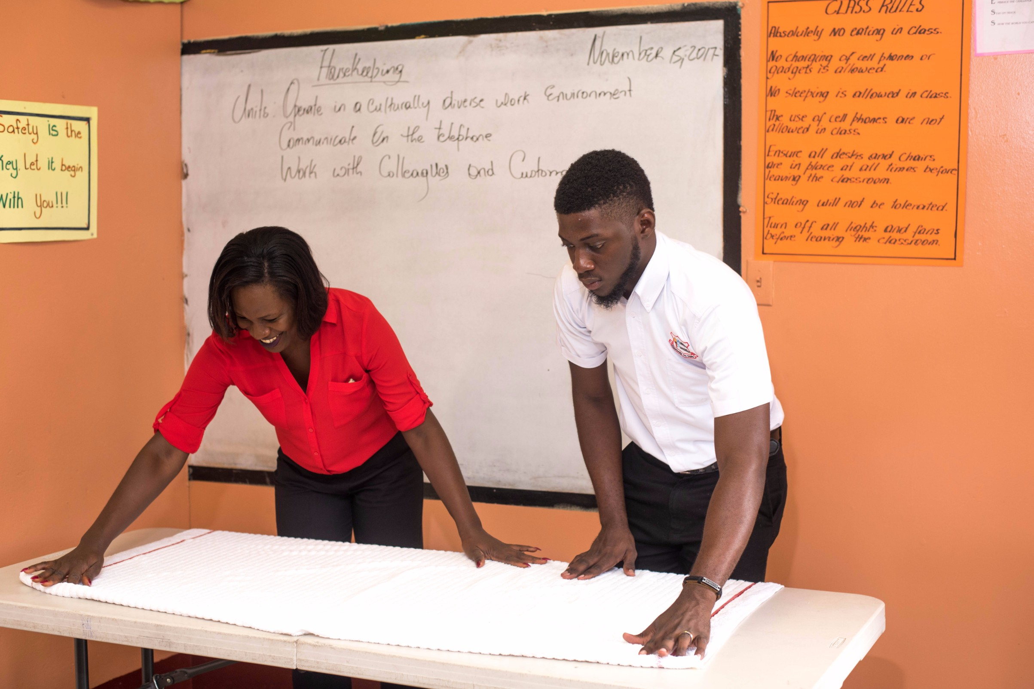
What Should Students Do for Transition Preparation?
Be engaged and active in the process:
  Become aware of self know more about interests, preferences, strengths, and areas for improvement
  Be motivated and focused in pursuing areas of interests and goals for learning or job-preparation

Slide 34
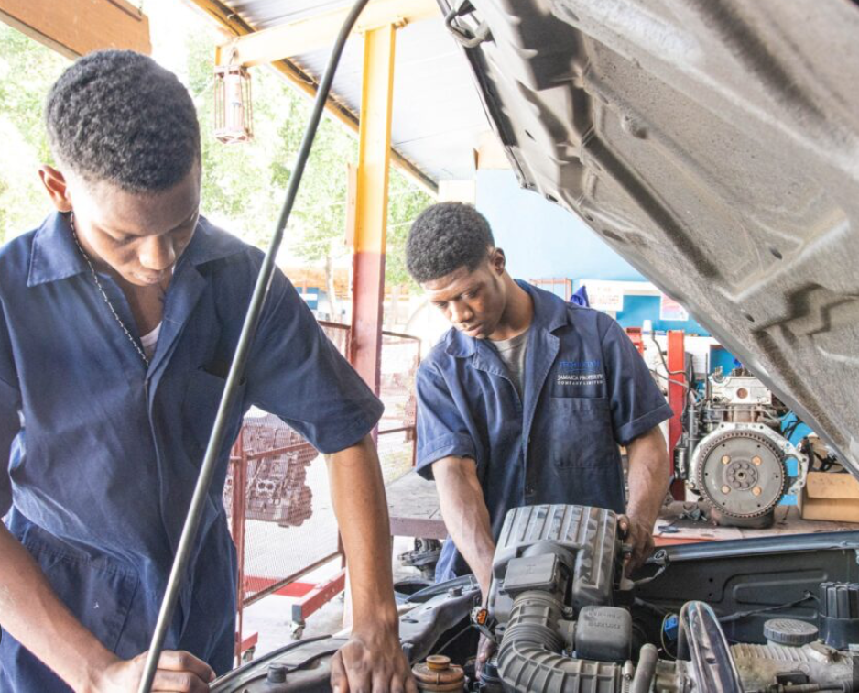
What Should Students Do for Transition Preparation?
  Be involved in activities that lead to job-interests, career exploration
  Take advantage of opportunities for paid or unpaid work experience
  Become aware of, and pursue services and supports to help them while in school, or beyond school.

Slide 35
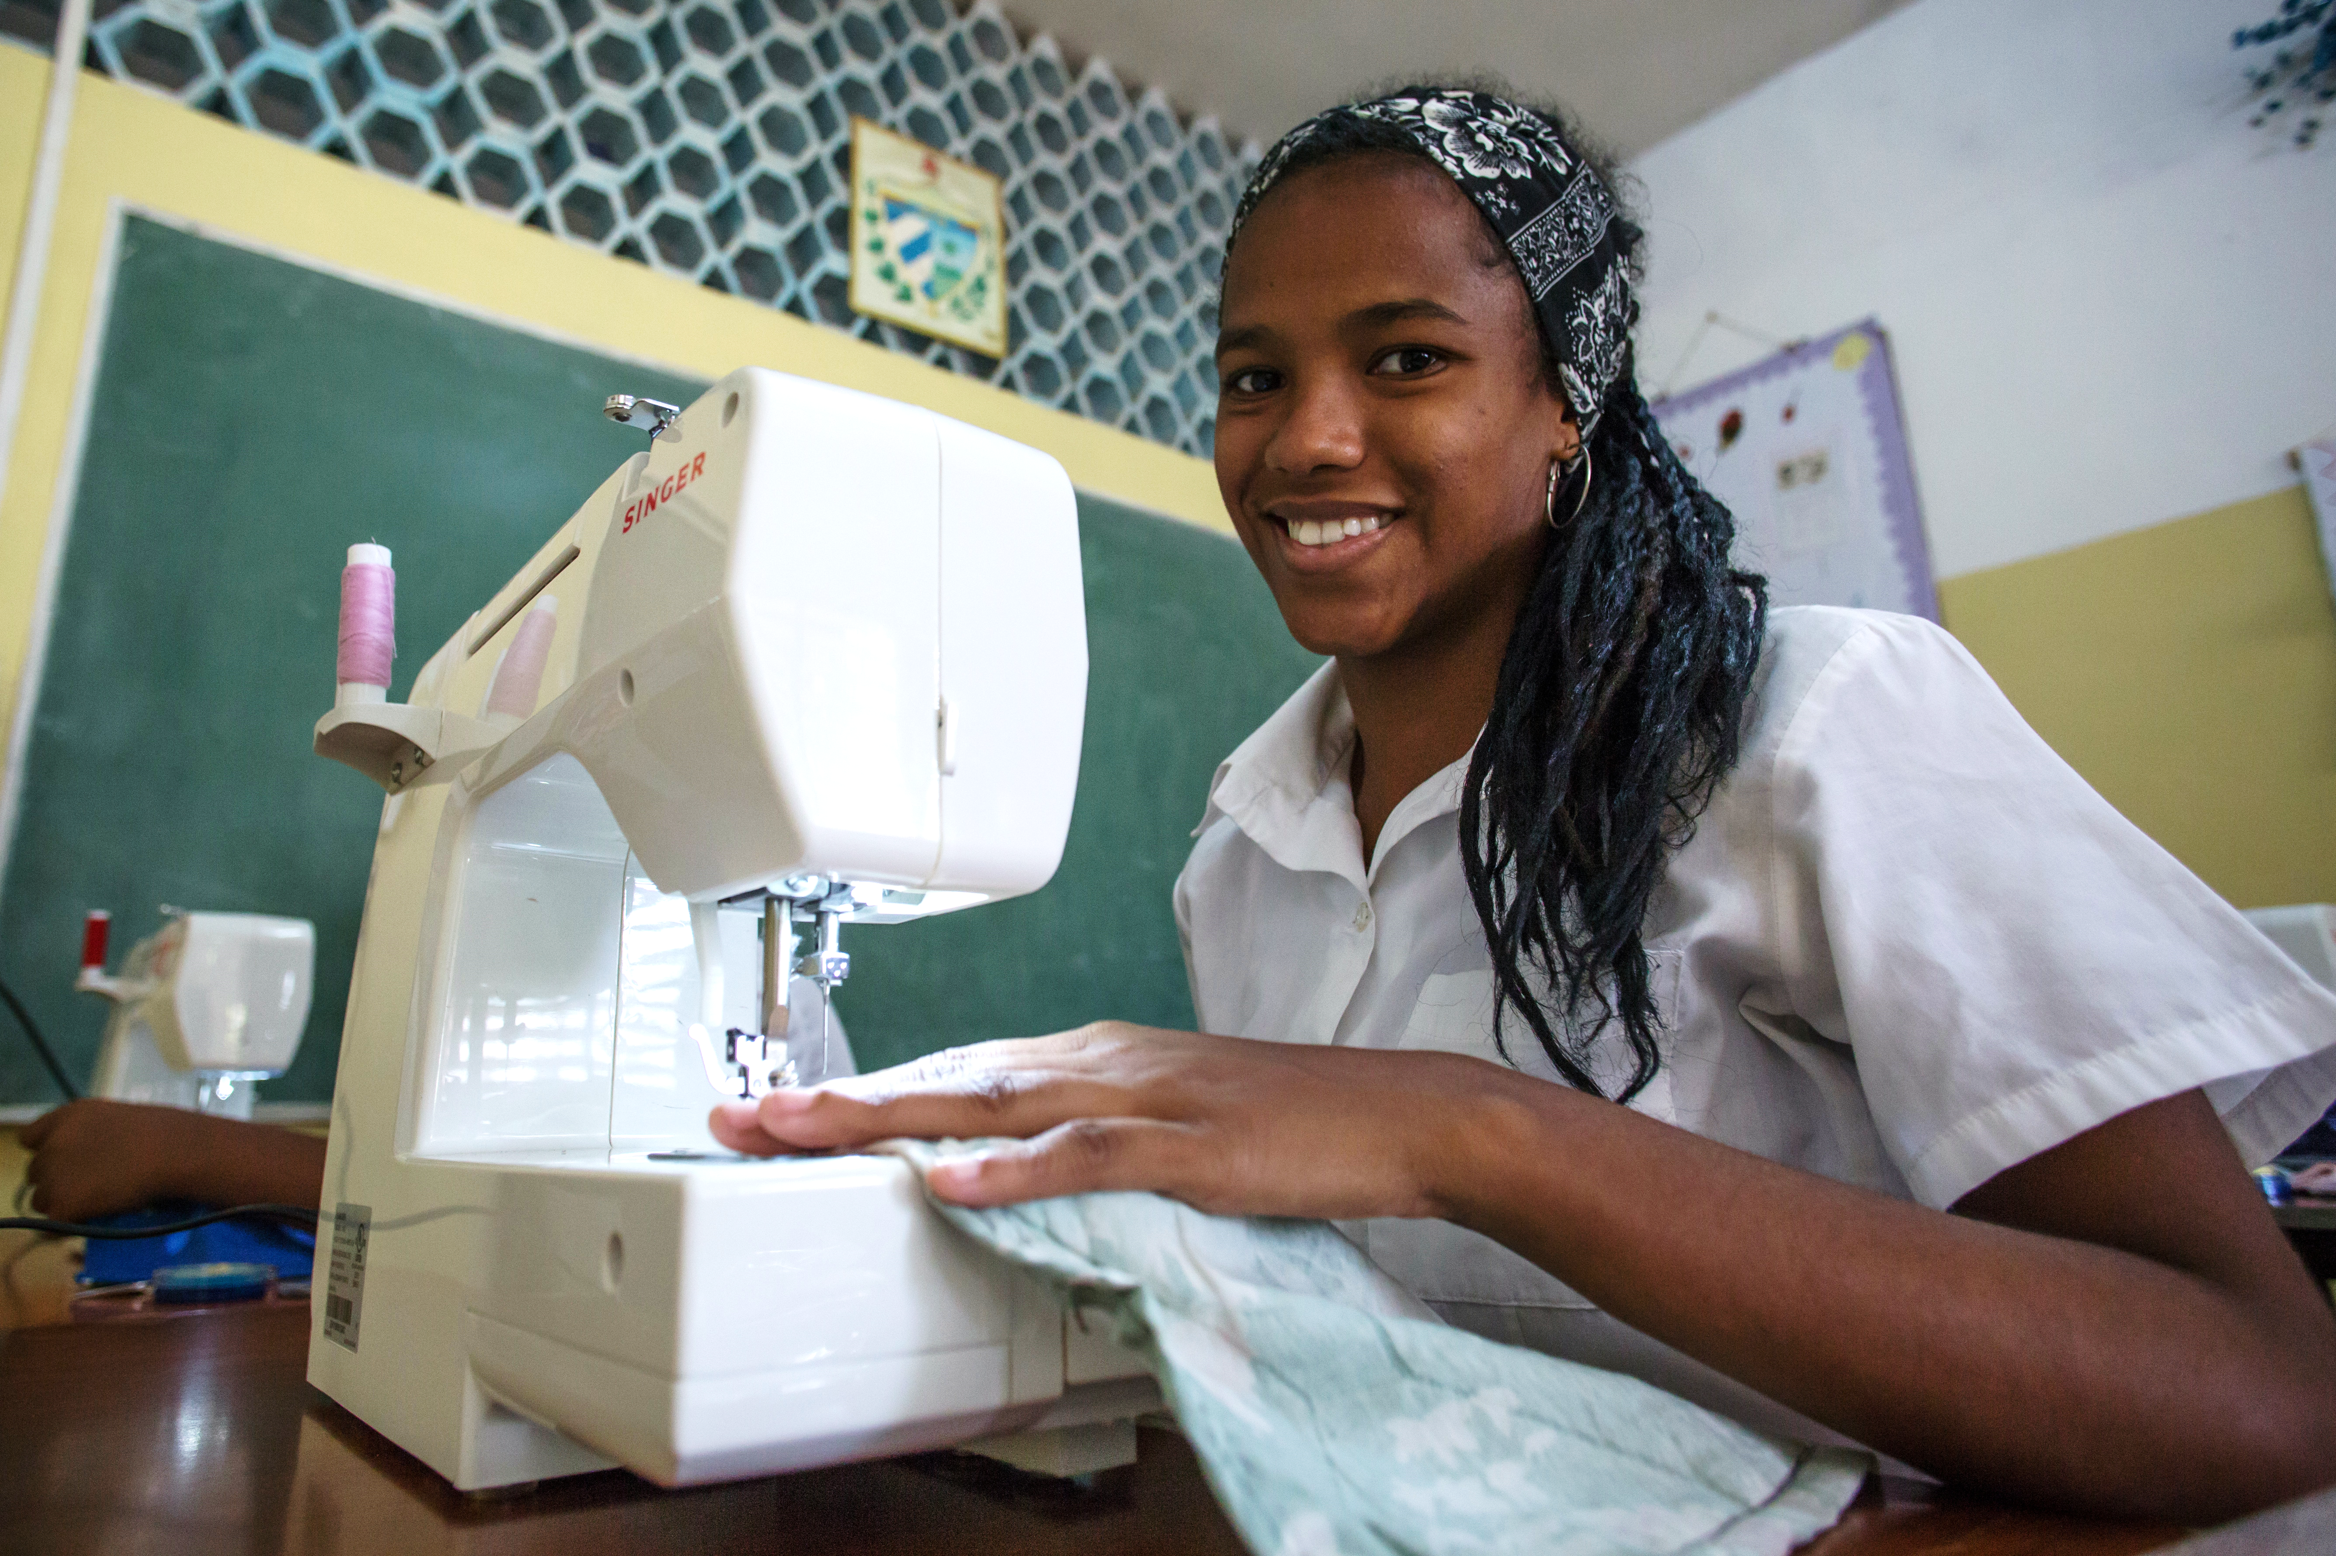
What Should Teachers Do for Transition Preparation?
Provide relevant and appropriate educational and experiences to support transition goals.
Support students in helping them to identify interests, and work towards goals and plans for the future.
Provide activities that encourage career awareness and exploration

Slide 36
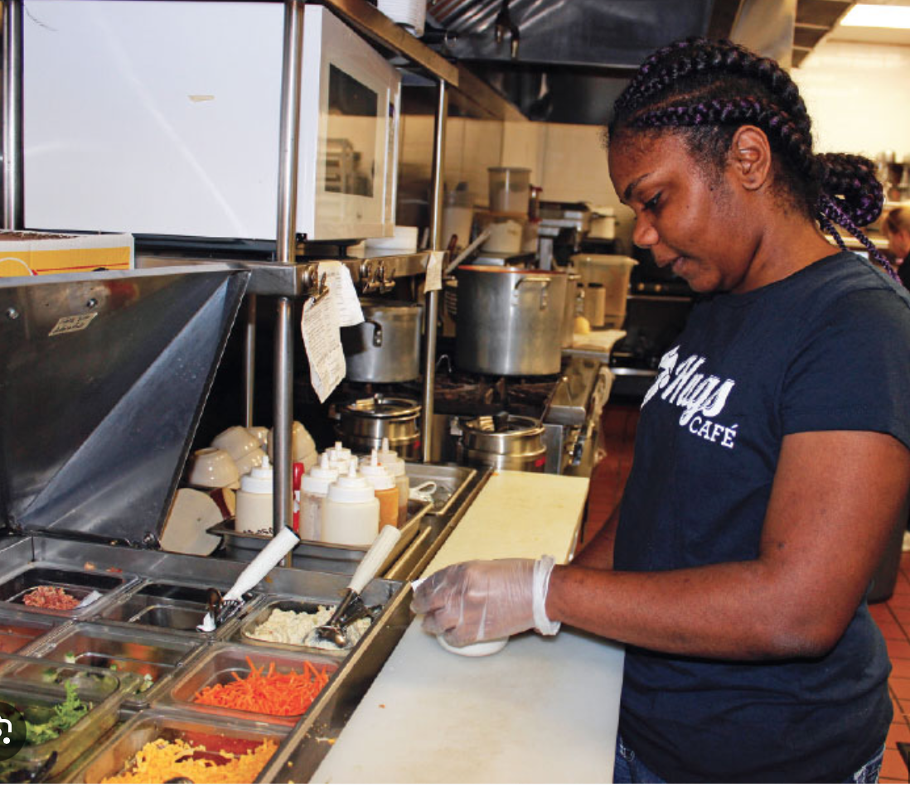
What Should Teachers Do for Transition Preparation?
Provide practical experiences to support social/community integration, adult responsibilities.
Provide opportunities to encourage self-advocacy, independent decisions, problem-solving skills.
Provide opportunities for students to discover or explore related support and services in school or community.

Slide 37
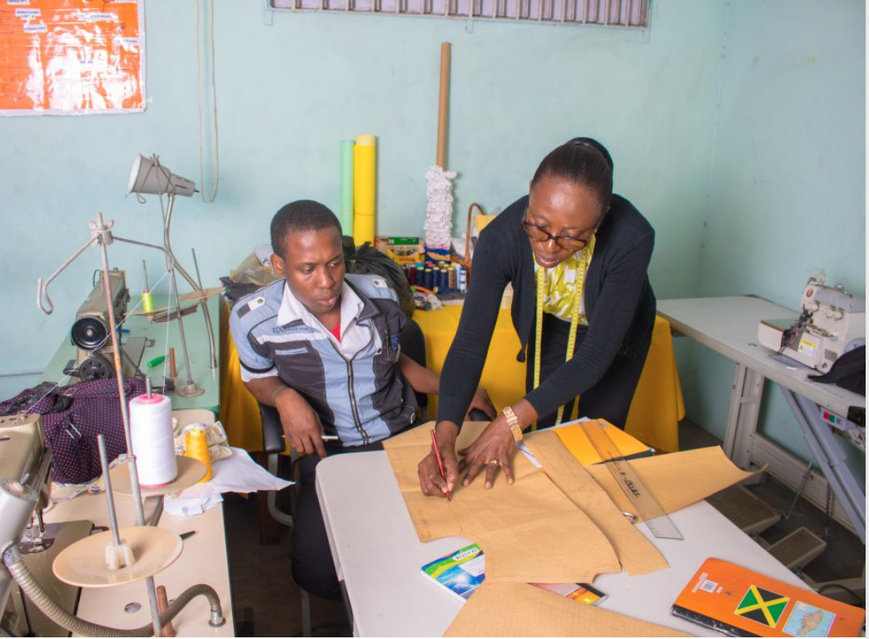
What do I do now?
Talk with your child’s teacher about transition goals.
Talk with your child about goals for after school.
Learn about the service and support agencies that may help with your child’s transition goals.
Identify relatives, friends, or associates who may support you and your child through transition.

Slide 39

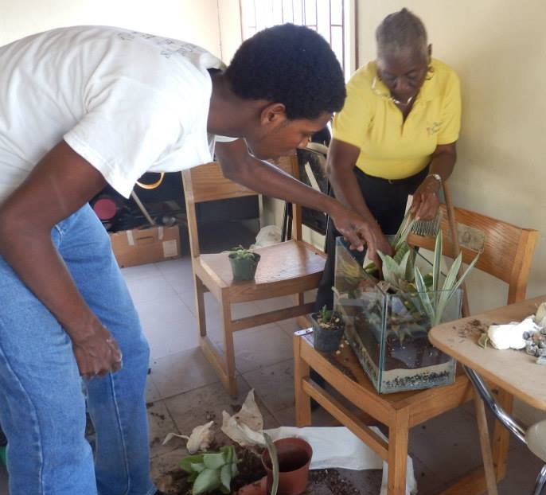
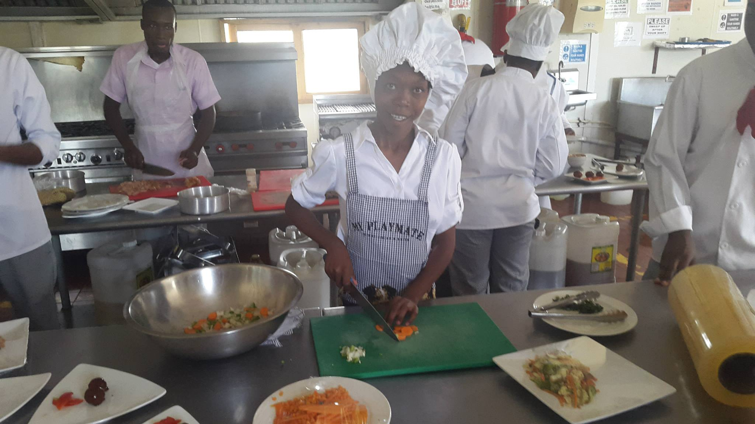

Slide 40

TEACHERS
SERVICE AGENCIES

Slide 41
Thank You!

