Slide 1
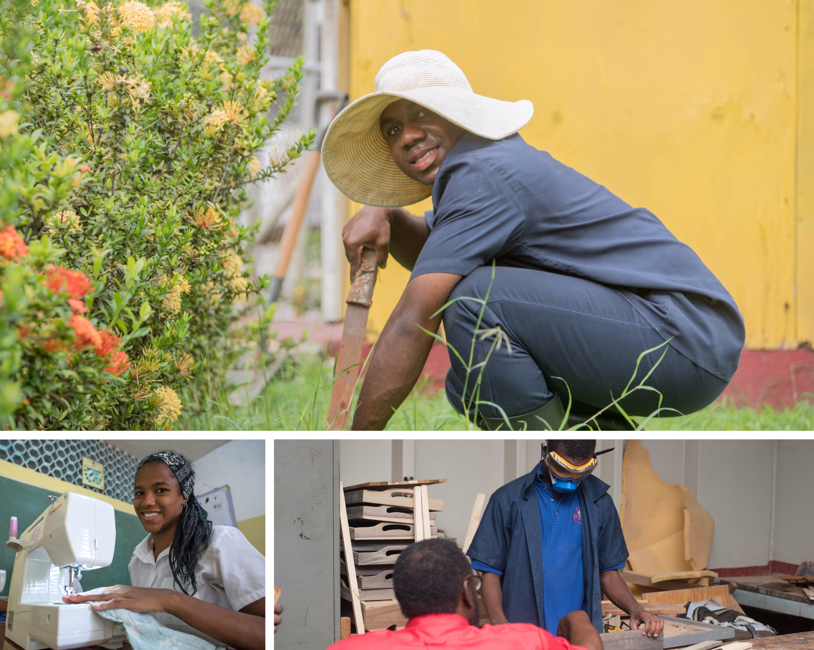

Developing School-to-Work Transition Plans
PRESENTER
Michele A. Meredith (PhD)
July 2023

Slide 2
X
STWT Planning Team
Transition Personnel
Special Educator
Family
General Educator or
TVET Teacher
School System Representative
Clinical Personnel
Guidance Counsellor
Transition Service Agency
Advocate
Family Support

Slide 3
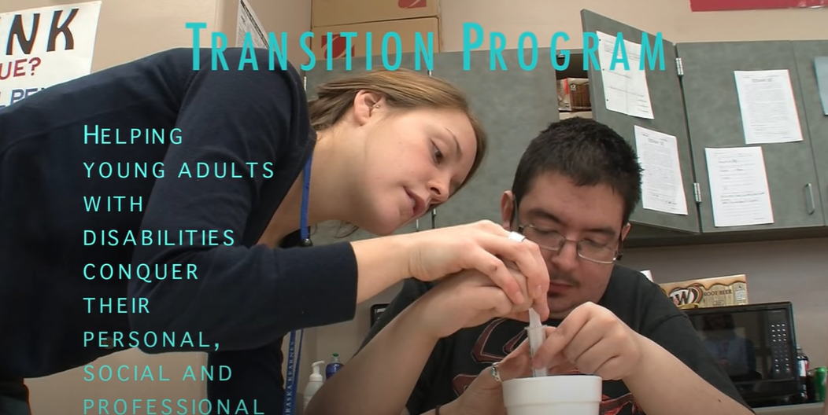


Task
X
Click on the links below and watch the following videos.
https://youtu.be/j8X-oXCQGk8 Transition Program
https://youtu.be/-2agKXF6y6E – Transition Program – Open Doors
https://youtu.be/Bz-VdCA7qZ4
Transition School-to-Work Program
Questions
What major points or issues have you identified from the videos?
What is eligibility-based decision making?
What interests or goals have these students shared in relation to transition planning?

Slide 4
Video Summary Discussion
X
What major points or issues have you identified from the videos?
What is eligibility-based decision making?
What interests or goals have these students shared in relation to transition planning?

Slide 5
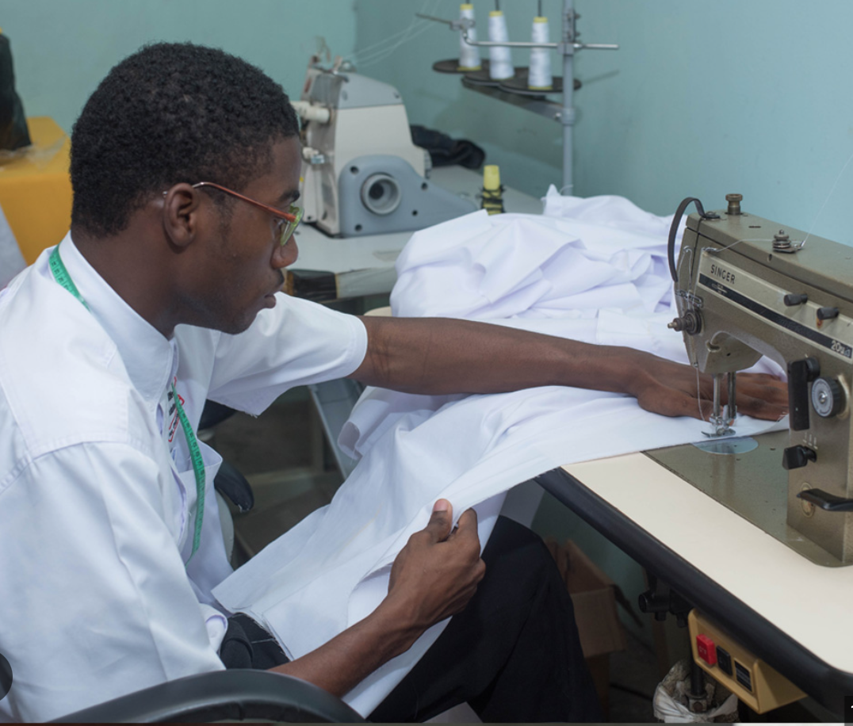
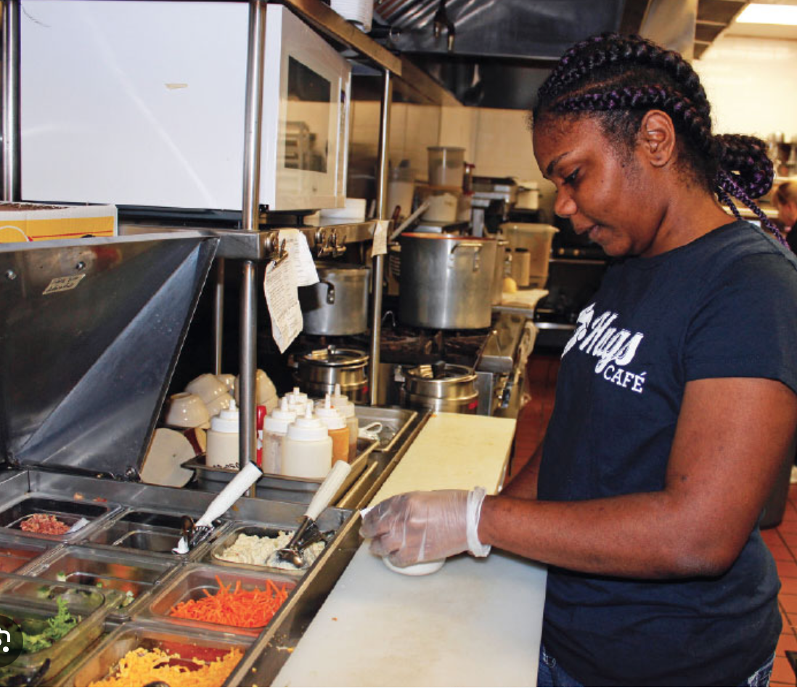
Elements of Transition Planning
X
Academics
  IEP goals
  Vocational skills
  Interests/aptitude
  Self-determination
Transition Assessments
  Independent living
  Post-secondary goals
  Training/education
Service Access
  Employment placement services
  Agencies to support transition

Slide 6

X
Non-academic Elements
Community Mobility
House-keeping
Budgeting/Shopping
Financial Responsibility
Self-advocacy
Social Integration
Family
Friends
Dating
Marriage
Parenting
Adult Children
Health-care
Nutrition/Diet
Exercise
Self-care
Leisure Activities

Slide 7
An Overview of the Taxonomy for Transition Programming 2.0
X
Student-Focused Planning
IEP Development
Planning Strategies
Student Participation
Program Structure
Program Characteristics
Program Evaluation
Strategic Planning
Policies and Procedures
Resource Development and Allocation
School Climate
Student Development
Assessment
Academic Skills
Life, Social, and Emotional Skills
Employment and Occupational Skills
Student Supports
Instructional Context
Family Engagement
Family Involvement
Family Empowerment
Family Preparation
Interagency Collaboration
Collaborative Framework
Collaborative Service Delivery
Maryland Centre for Developmental Disabilities, Kennedy Kruger Institute

Slide 8
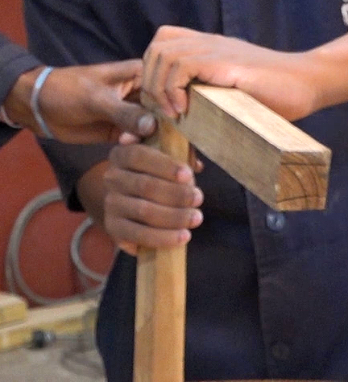



CASE STUDIES
GROUP ACTIVITY
X

Slide 9



Key Persons for Transition Preparation
X
Transition Planning Team
(General Educator, Special Educator,
Transition Coach/Specialist, Guidance Counsellor)
Family
(Caregiver/Mentor/Advocate)
Community Partners

Slide 10
CASE STUDIES
GROUP ACTIVITY
X

Slide 11
Case Study 1 - Joel
X
Joel is 16 years old. He was diagnosed at age 10 with Asperger’s Syndrome. His academic performance shows advanced skills in Mathematics and Science-related subjects, and language. He describes himself as a misfit because he finds it difficult to maintain friendships with his peers. He spends a lot of time in the school library, reading or using his device. Joel’s parents want him to start thinking about his future. He wants to be a computer game programmer. He has identified a program at Compass School of Technology. He has asked his parents if he can sit CSEC Computer Studies and Mathematics, although he is not yet at the grade level to do so. His teacher has shared his concern about Joel’s challenges and how his development might be affected. He is happy that Joel is functioning well academically, but he does not seem to do well socializing with his peers. The parents have asked for a preliminary meeting to address the concerns.
What would the critical issues be for this discussion?
Who are the persons who should be at this meeting?
Name action to be taken following this meeting. List the actions in order or priority.

Slide 12
Feedback on Case Study 1 – Joel
X
Joel is 16 years old. He was diagnosed at age 10 with Asperger’s Syndrome. His academic performance shows advanced skills in Mathematics and Science-related subjects, and language. He describes himself as a misfit because he finds it difficult to maintain friendships with his peers. He spends a lot of time in the school library, reading or using his device. Joel’s parents want him to start thinking about his future. He wants to be a computer game programmer. He has identified a program at Compass School of Technology. He has asked his parents if he can sit CSEC Computer Studies and Mathematics, although he is not yet at the grade level to do so. His teacher has shared his concern about Joel’s challenges and how his development might be affected. He is happy that Joel is functioning well academically, but he does not seem to do well socializing with his peers. The parents have asked for a preliminary meeting to address the concerns.
What would the critical issues be for this discussion?
Who are the persons who should be at this meeting?
Name action to be taken following this meeting. List the actions in order or priority.

Slide 13
Case Study 2 - Carel
X
Carel is 15 years old. She lives with her family including two younger siblings. Her mother is an Art teacher. Carel attends one of the Schools of Hope. Her mother has noticed that she has an interest in sewing. Although her speech is not clear, Carel is very vocal and tries to make her needs known. Her mother has noticed that she writes her requests and places her notes on the refrigerator. Her mother has described her as being very neat, often taking the initiative to clean her room and her siblings’ rooms. She also spends time in the kitchen with her mother, and also attempts to prepare sandwiches and drink for the family. Carel enjoys school. Her teacher has observed that she is often impatient, and displays tantrum-like behaviors when she does not get to do an activity she initiates in class, although the task was not assigned by the teacher. Mom has been invited to Carel’s IIP meeting.
What should be the focus of this meeting?
What advice should Mom be given regarding Carel’s behavior at home.
What are the key steps that should be addressed by the IIP team after this meeting?
List the actions in order of priority.

Slide 14
Feedback on Case Study 2 – Carel
X
Carel is 15 years old. She lives with her family including two younger siblings. Her mother is an Art teacher. Carel attends one of the Schools of Hope. Her mother has noticed that she has an interest in sewing. Although her speech is not clear, Carel is very vocal and tries to make her needs known. Her mother has noticed that she writes her requests and places her notes on the refrigerator. Her mother has described her as being very neat, often taking the initiative to clean her room and her siblings’ rooms. She also spends time in the kitchen with her mother, and also attempts to prepare sandwiches and drink for the family. Carel enjoys school. Her teacher has observed that she is often impatient, and displays tantrum-like behaviors when she does not get to do an activity she initiates in class, although the task was not assigned by the teacher. Mom has been invited to Carel’s IIP meeting.
What should be the focus of this meeting?
What advice should Mom be given regarding Carel’s behavior at home.
What are the key steps that should be addressed by the IIP team after this meeting?
List the actions in order of priority.

Slide 15
CASE STUDIES
GROUP ACTIVITY
X
Work in your groups to discuss the case studies on the next three slides.

Slide 16
Case Study 3 - Jason
X
Jason was diagnosed recently with Learning Disability and Attention Deficit/Hyperactivity Disorder (Inattentive). His functioning profile shows that he is a stronger student in language skills than he is in Mathematics. As an 8th-grader he is functioning at the level of a 6th grader. is, however functioning at the Grade 5 level Although he will do his work, Jason is often argumentative and reluctant to follow instructions. He is also inattentive, careless with his work, having to redo his tasks because they are not done well. His social interaction is affected by his inability to gauge social context. This results in misunderstandings between him and his classmates; a situation he changes by injecting humor.
The special educator has requested an IIP meeting to ensure that a plan to support him in high school. He has expressed interest in wood-craft and wants to do furniture design and construction. He spends a lot of time with Mr. Jackson, the Woodwork teacher and seems to enjoy his company, and reports that he seems very interested in furniture making.
When the team gets together, what should be the focus of this meeting?
Who should be involved in this meeting?
What specific goals should be identified for Jason?
List the goals in order of priority.

Slide 17

Case Study 4 - Dianne
X
Diane is a 9th grade student diagnosed with Low Vision. She is a transfer student from a school in which she was receiving some support through an IIP. Since she has been at her new school, she has not had the support to help her integrate in the school community. She functions at her grade level academically, and has good communication skills. At her former school she had begun a program in data processing; but she wants to do journalism on humanitarian issues. Dianne’s mother is terminally ill, and her aunt is her main caregiver. She has requested a meeting to discuss Dianne’s educational plan and future.
What should be the focus of the discussion in this meeting?
Who should attend this meeting?
What are the specific goals to be identified for Dianne?
List the goals in order of priority.

Slide 18
Case Study 5 - Jeremy
X
Jeremy lives with his parents and older brother. He is in 9th grade. He is hearing impaired. Jeremy’s father is an accountant and his mother works as a binder and in the printer. Jeremy is very creative and does beautiful binding, making books as gifts. Jeremy wants to be an accountant, like his father. He is a strong student and is advanced in Mathematics and Science subjects, and at grade level in all other subject areas. He is popular in school, but now finds himself in need of some additional support. He has managed to get by with lip-reading and the use of his hearing aid. As he gets older, his hearing loss is affecting him increasingly. He needs more support and guidance toward accomplishing his goals for the future. The Work Experience teacher has requested a meeting.
What should the focus of discussion be for this meeting?
Who should attend this meeting?
What specific issues should be discussed regarding Jeremy?
What goals should be identified for Jeremy?
List the goals in order of priority.

Slide 19
PLENARY
X
Group Presentations

Slide 20
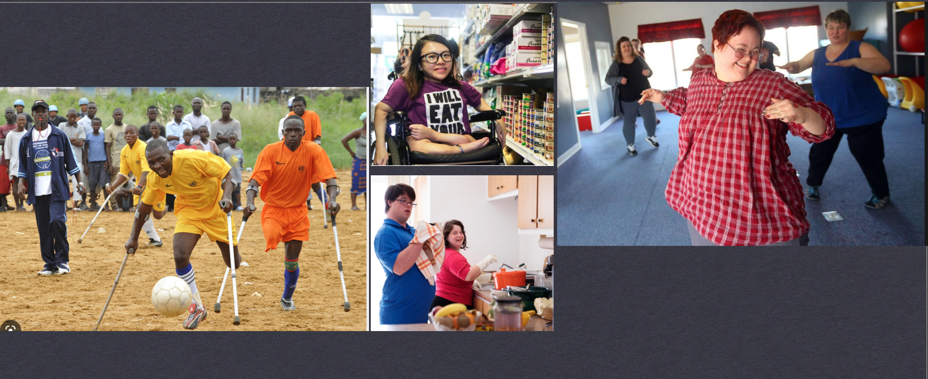
X
LIVING, WORKING, AND INTEGRATING INTO FAMILIES AND COMMUNITIES

Slide 21
Questions & Answers
X

