Slide 1


School-to-Work Transition
Information Session
Michele A. Meredith (PhD)
Consultant
July 2023

Slide 2
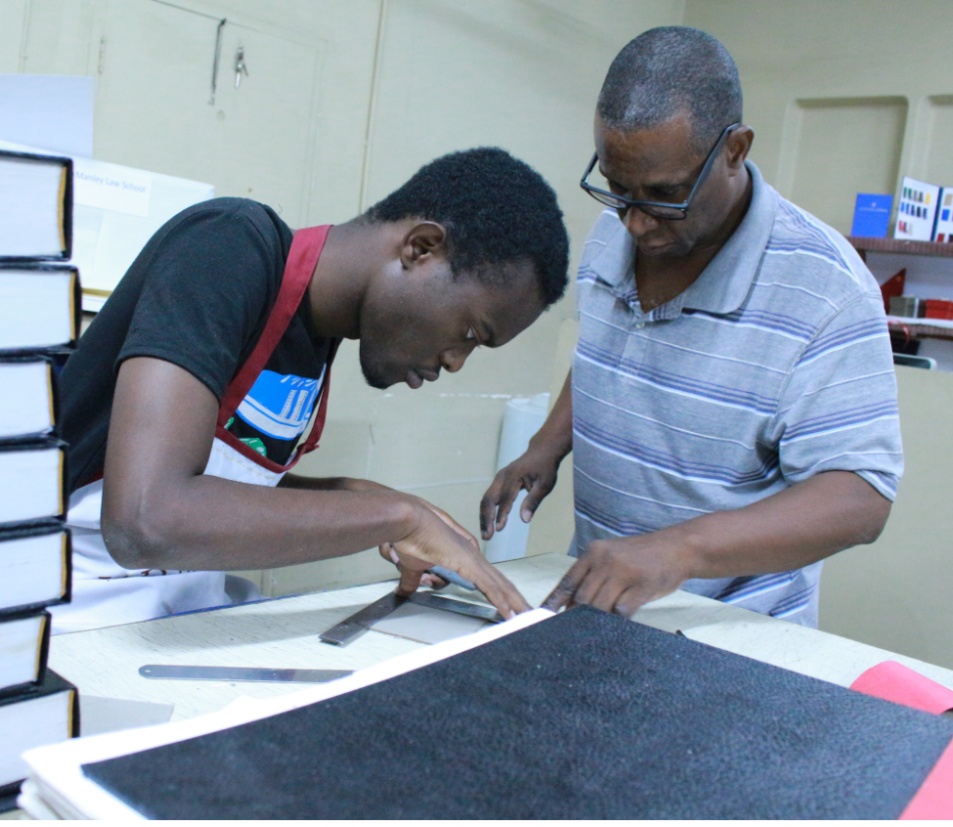
Overview
Equity
Access
Relevance
Notes:
Athletes participate in the third | Free Photo - rawpixel
Visit
Get this image on: Rawpixel | License details
Creator: rawpixel.com / U.S. Embassy South Africa (Source) | Credit: rawpixel.com / U.S. Embassy South Africa (Source)
Want to know where this information comes from? Learn more
https://www.rawpixel.com/image/6485826/photo-image-public-domain-woman-people
https://www.rawpixel.com/image/3388518/free-photo-image-people-arms-2015-department-defense-warrior-games
https://www.rawpixel.com/image/4234748/photo-image-people-woman-photos

Slide 3
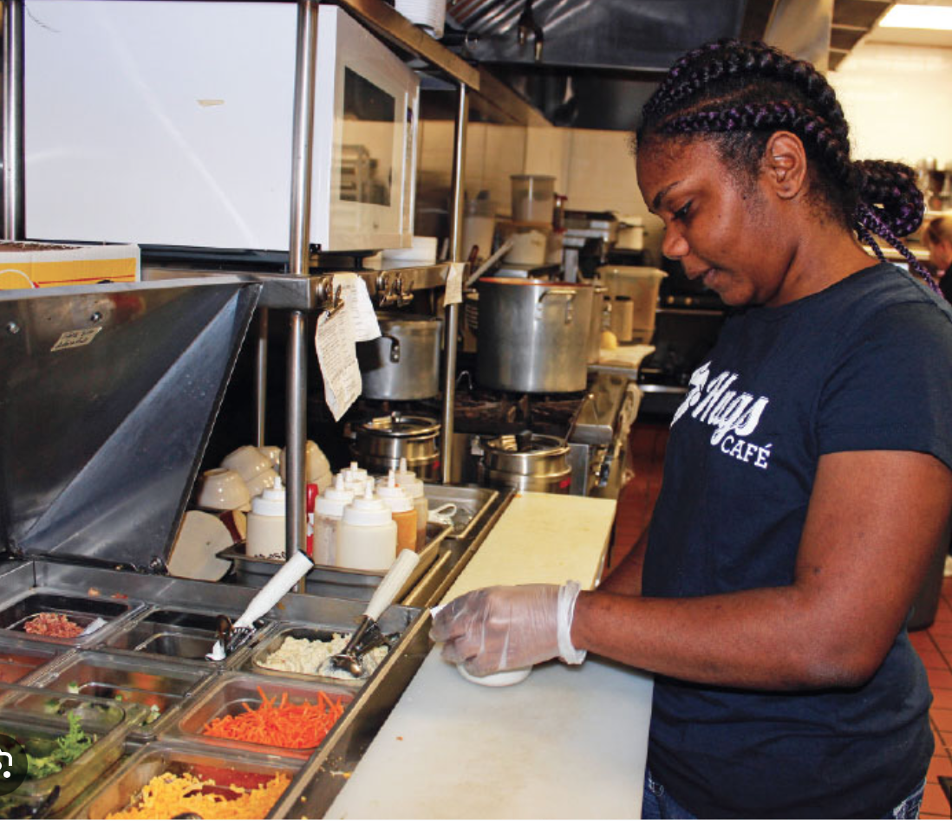
What is School-to-Work Transition?
Preparatory steps toward assuming adult roles and responsibilities after school
Also called: ‘education-to-work transition’

Slide 4

Phases of School-to-Work Transition
Transited into settled employment; and other post-school activities
Transitioning into employment and other post-school activities
Preparation for employment and other post-school activities

Slide 5
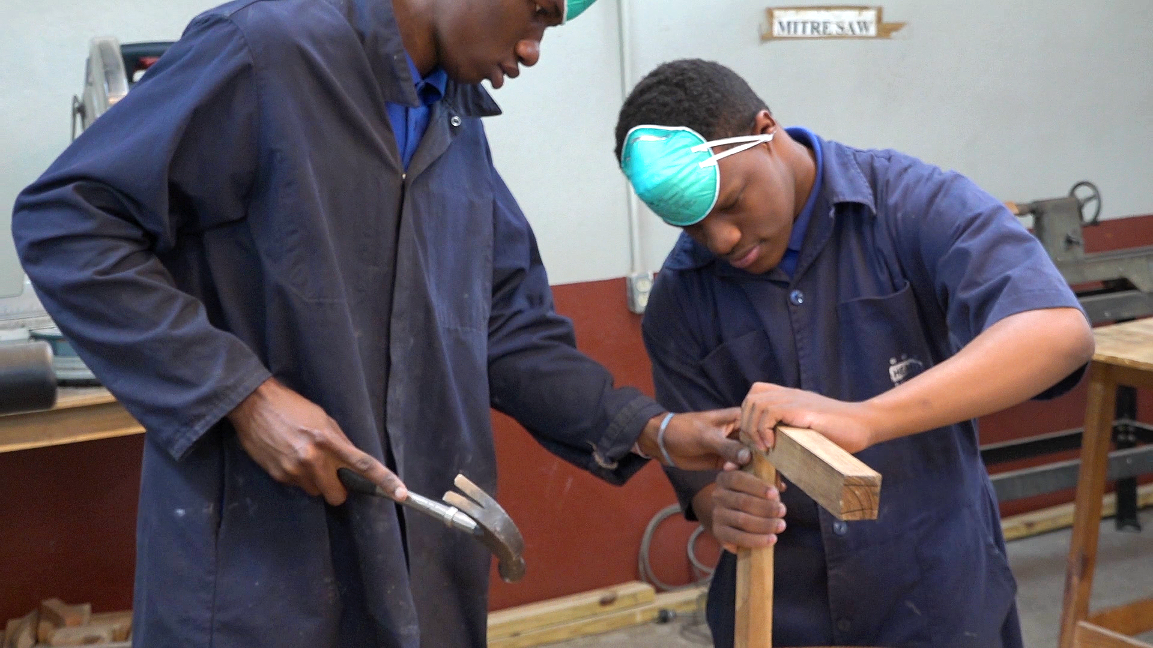
What is School-to-Work Transition?

Slide 6
Phases of School-to-Work Transition
Transition Not Yet Started | In Transition | Transited
A young person whose “transition has not yet started” is one who is either of the following: still in school and inactive (inactive students); or currently inactive and not in education or training *(inactive non-students), *with no intention of looking for work. | A young person is still “in transition” if their status is one of the following: currently unemployed ; or currently employed in a temporary and non-satisfactory job; or currently in non-satisfactory self-employment; or currently inactive, and not in education or training, with an aim to look for work later. | A young person who has “transited” is one who is currently employed in: a stable job, whether satisfactory or non-satisfactory; or a satisfactory but temporary job; or satisfactory self-employment. (Source: https://www.ilo.org/global)

Slide 7
Other Aspects of STWT
Life, social, and emotional skills
Relationships
Wellness and Health
Independent Living
Community Living and participation

Slide 8
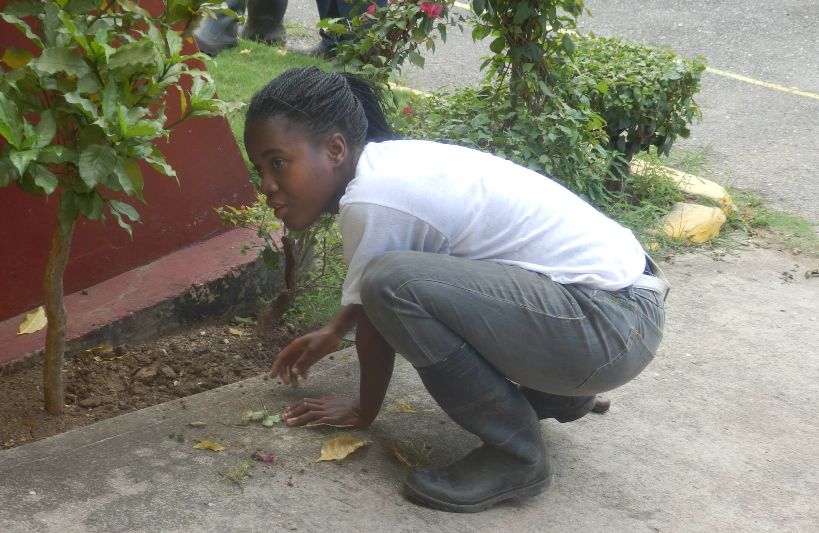
Elements of Transition Planning
Academics
IEP goals
Vocational skills
Interests/aptitude
Self-determination

Slide 9
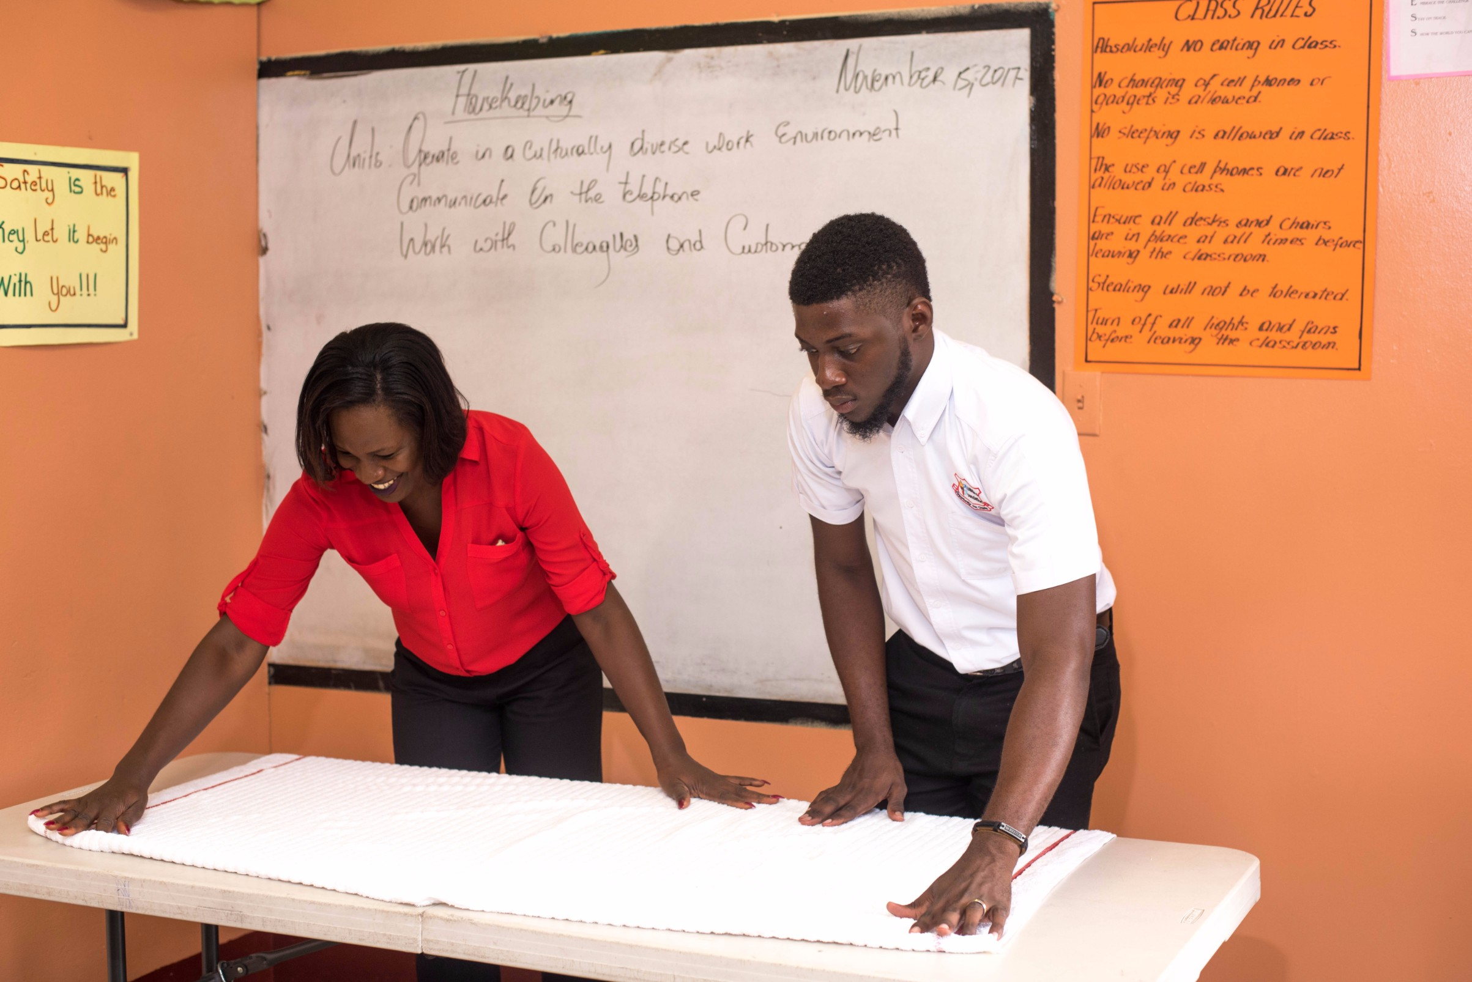
Elements of Transition Planning
Transition Assessments
Independent living
Post-secondary goals
Training/education

Slide 10
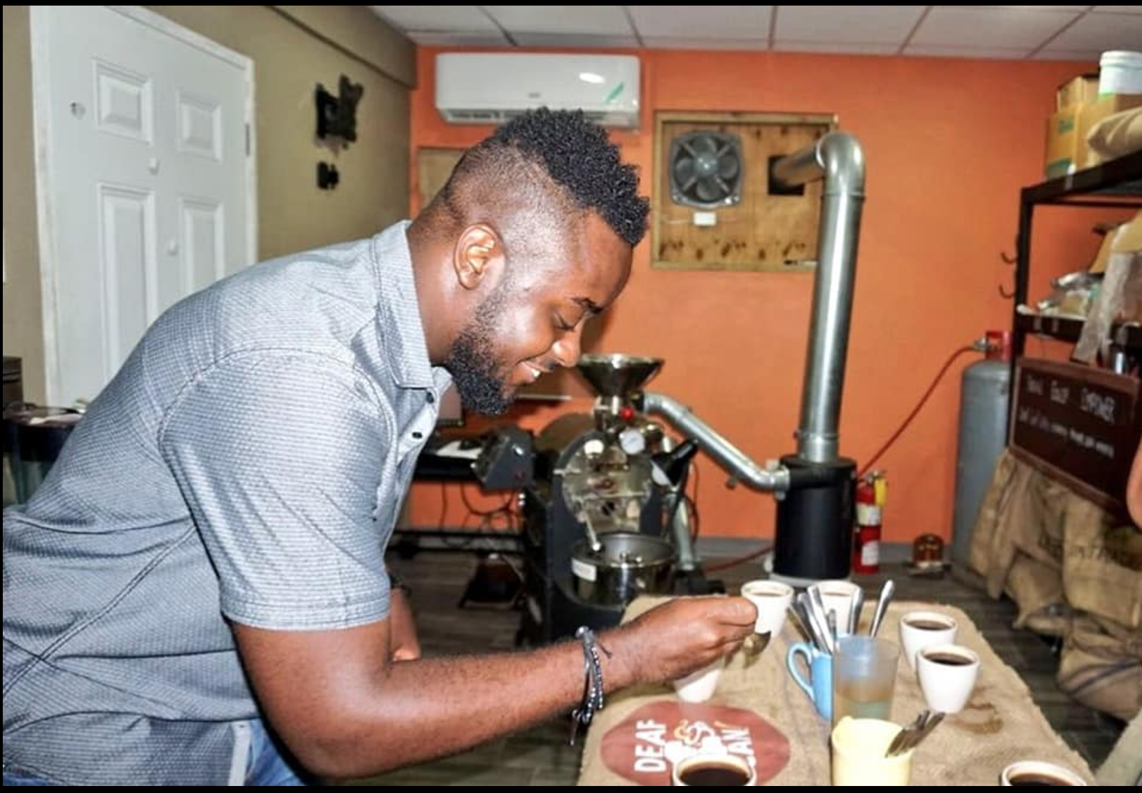
Elements of Transition Planning
Service Access
Employment placement services
Agencies to support transition

Slide 11
An Overview of Transition Planning
Student-Focused Planning
Program Structure
Student Development
Family Engagement
Interagency Collaboration
Maryland Centre for Developmental Disabilities, Kennedy Kruger Institute

Slide 12
An Overview of the Taxonomy for Transition Programming 2.0
Student-Focused Planning
IEP Development
Planning Strategies
Student Participation
Family Engagement
Family Involvement
Family Empowerment
Family Preparation
Student Development
Assessment
Academic Skills
Life, Social, and Emotional Skills
Employment and Occupational Skills
Student Supports
Instructional Context
Program Structure
Program Characteristics
Program Evaluation
Strategic Planning
Policies and Procedures
Resource Development and Allocation
School Climate
Interagency Collaboration
Collaborative Framework
Collaborative Service Delivery
Maryland Centre for Developmental Disabilities, Kennedy Kruger Institute

Slide 13
The Transition Planning Process
Transition Plan Implemented
and Evaluated
  Student
  Family
  Teachers
  Guidance Counsellor
  Transition Coach/Specialist
  Student
  Transition Coach
  Guidance Counsellor
  Teachers
  Family
  Community Partners
  Service Agencies
  Teachers
    Special Educator
    TVET
  Student
  Family
  Transition Coach/Specialist
  Community Partners
  Service Agencies
Transition Planning
Transition Preparation
Work-Experience

Slide 14
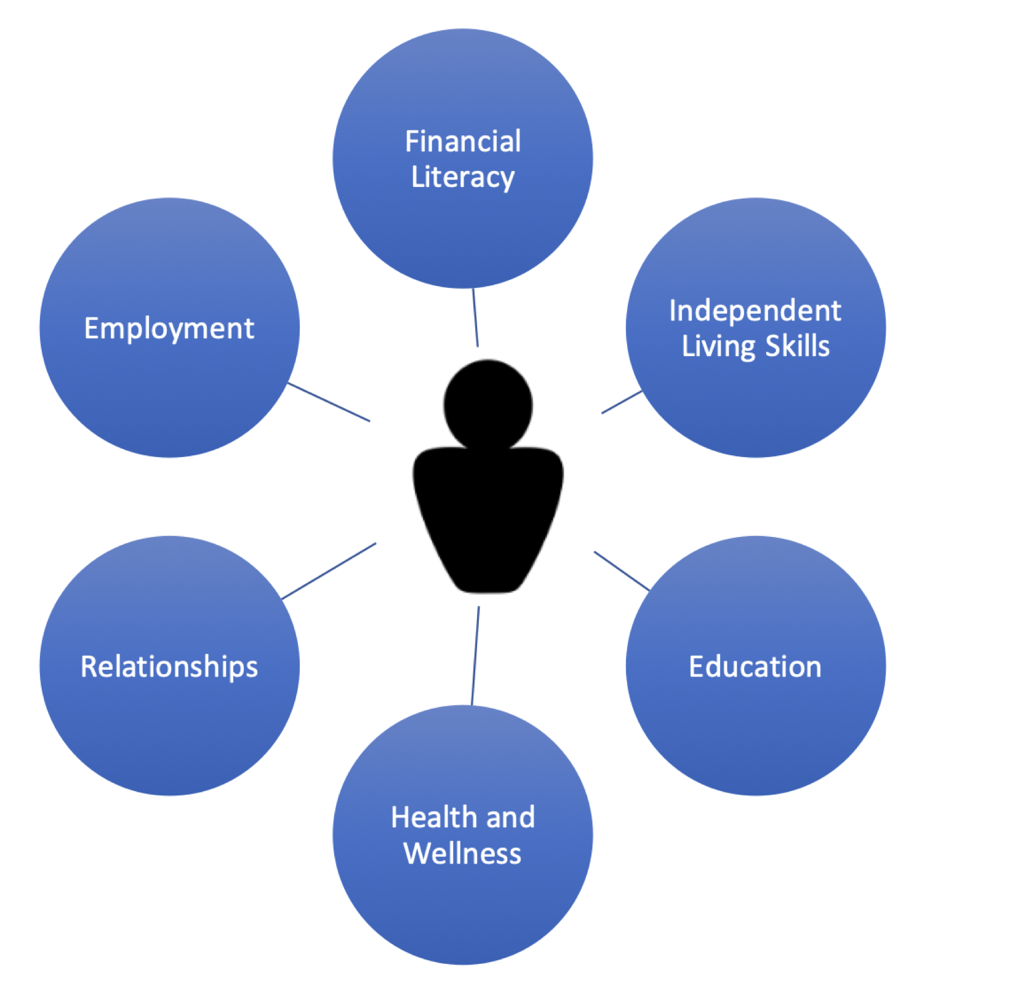
Non-academic Elements
Community Mobility
House-keeping
Budgeting/Shopping
Financial Responsibility
Self-advocacy
Social Integration
Family
Friends
Dating
Marriage
Parenting
Adult Children
Health-care
Nutrition/Diet
Exercise
Self-care
Leisure Activities

Slide 15
Purpose of Transition Planning
The Whole Person
Career Developmental Cycle
Abilities
Skills
Interests
Personal Style
Family
Values
Goals
TO:
Identify desires, strengths, and interests
Cultivate mutually beneficial relationships for both families and professionals
Allow for coordination among educators and case managers and service agencies

Slide 16
Purpose of Transition Planning
The Whole Person
Career Developmental Cycle
Abilities
Skills
Interests
Personal Style
Family
Values
Goals
TO:
Develop targeted goals towards services for successful outcomes
Identify increased opportunities for community involvement
Provide increased support network
Facilitate self-determination, choice-making, self-advocacy

Slide 17
Key Persons for Transition Preparation
TRANSITION PLANNING TEAM
General Educator
Special Educator
Transition Specialist
Guidance Counsellor
FAMILY
Caregiver
Mentor
Advocate
COMMUNITY PARTNERS

Slide 18
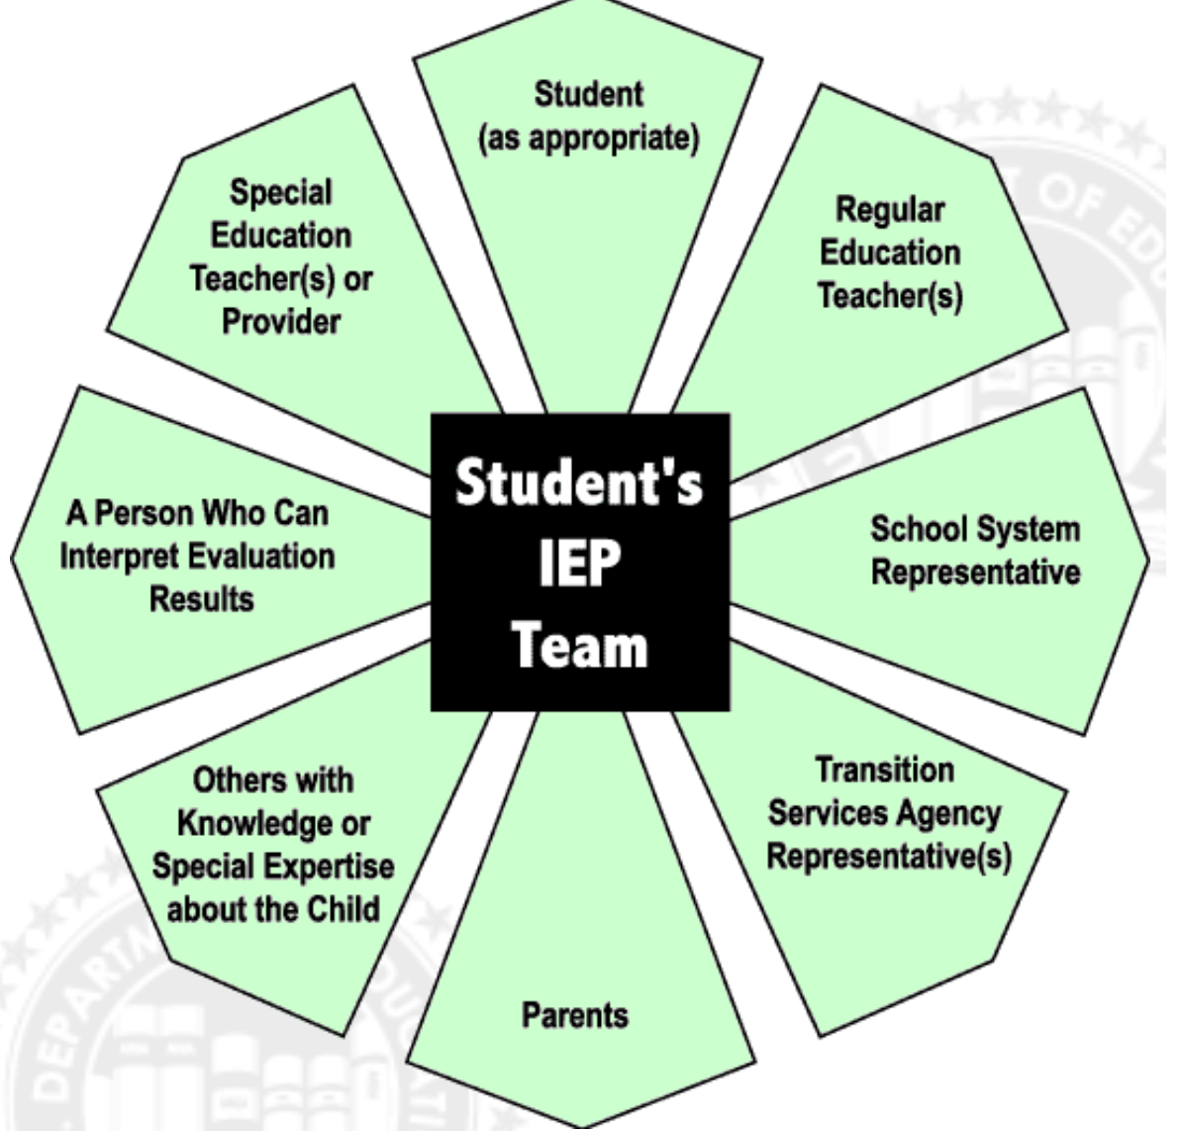

Slide 19
Bridging the Gap Between Goals and Needs
Curriculum and training to reflect focus on the domains of functional academics, independent living, health and wellness, relationships

Slide 20
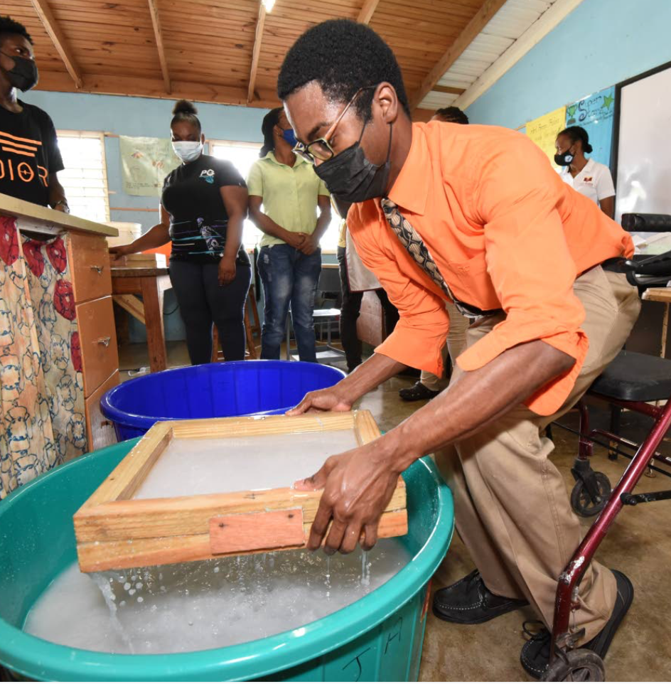
Bridging the Gap Between Goals and Needs
Awareness and Purposeful Planning
  Identifying community outlets and activities to support the development of the related skills
Forging Partnerships to Cultivate a Support Network
  Collaborating and planning with other organizations to support the transition of youth with special educational needs and disabilities

Slide 21
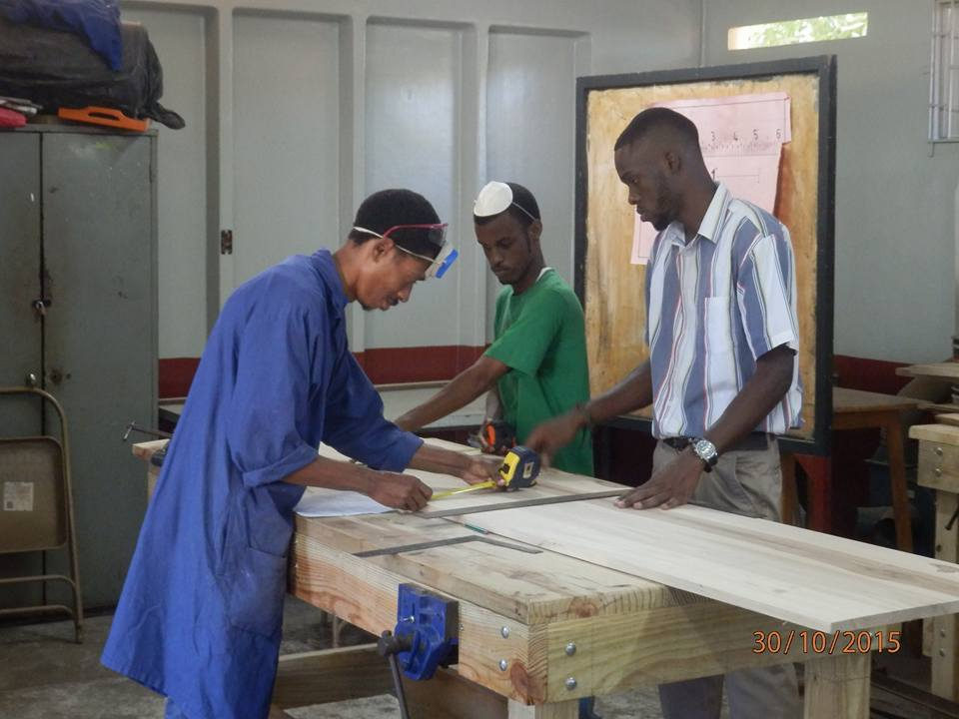
Bridging the Gap Between Goals and Needs
Capacity-building for instructional staff
Training to increase competencies
Collaborating to define roles and activities toward implementation of transition plans
Parent and family engagement
  Intentional and structured activities and interactions to support this aspect of development

Slide 22
Conclusion
Role of education:
Developing expectations, appropriate identities, attitudes, and dispositions to work.
Educational attainment is the most reliable predictor of transition success.
Attaining employment is one step … retaining employment is the ultimate goal.
Target for Transition:
Assuming adult roles and responsibilities
Social integration

Slide 23
School-to-Work Transition
Information Session
Michele A. Meredith (PhD)
Consultant
July 2023

