Slide 1
COMMUNITY OF PRACTICE
Presented by: Michele A. Meredith (PhD)
Consultant

Slide 2
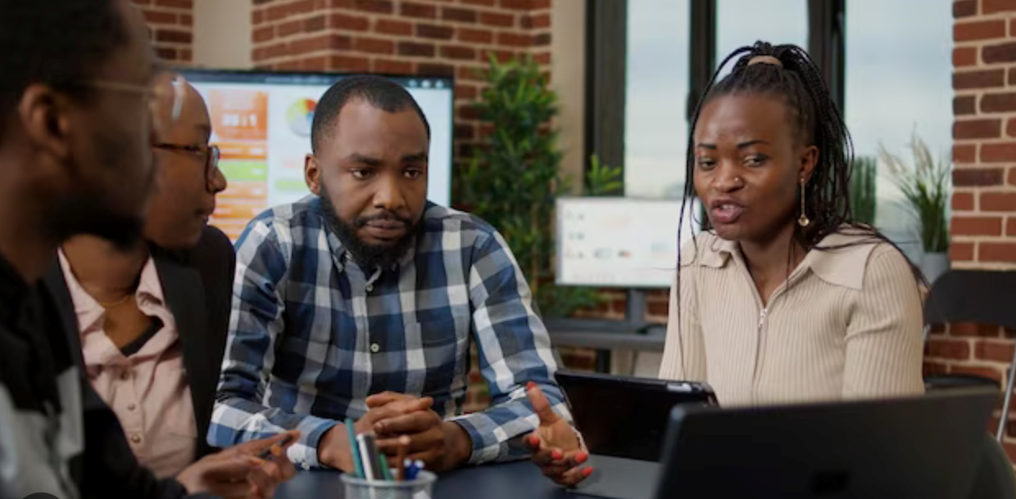
Introduction
Completion of Training Phase
We are still in need of:
A system for implementation of school-to-work programmes
We have discussed:
School to work transition planning and preparation
Taking goals from curricula
Identifying competencies and sub-competencies

Slide 3
Geographic Location

Slide 4
Supporting one another
Continuing
the
Discussions
Being Supported
Practicality of School-to-Work Transition
Your specific school context
The broader Jamaican education system

Slide 5
Community of Practice

Slide 6
Purpose of the CoP
Mutual Support and Accountability
Mutual Professional Respect
Capacity Building
Collaboration and co-operation
Professional interactions among different levels of staff
Mutual respect for ideas, experience, and exposure
Enriching activities
Shared ideas, concerns, and experiences
Room for encouragement
Formal and informal self-evaluation and peer-evaluation

Slide 7
Objectives
Community of Learning
Professional Learning Community
Support for educational leaders
and other levels of staff
Teachers
Tech-Voc Trainers
Other areas of teaching
and
Other types of school
Sharing
Share your thoughts with your colleagues
Follow the example in training:
Break-out groups
Group discussions
Zoom meetings

Slide 8
The CoP Participants should include:
Representative from the MoE
Rich guidance on the vision and perspective of the MoE
The Special Education Unit’s interpretation of those goals
Teachers with the content and information to share
Experiences are practical and relevant.
You have been using some strategies for transition-planning in your schools.

Slide 10
Creating the CoP
Spontaneous Discussion
Sharing Knowledge
Trust
Coming together around a common purpose or a common theme
Comfortable interactions lead to trust among those discussing the issues
Creater comfor leads to greater ease in sharing knowledge;
Sharing professional knowledge in a common pofessional language
Shared Practice
Collective Intelligence
Implicitly held Knowledge
Exchanging ideas and strategies
Sharing practical experiences
Sharing trial and error
Sharing common ideas
Working toward a common factor
Sharing common knowledge
All ideas coming together
Knowledge that you had all along
Learned through informal or incidental experiences
Other persons with same knowledge and experiences

Slide 11
The Local STWT CoP
The MoE should convene a ‘next-steps’ meeting
Agree among yourselves when you will meet in your parish or school groups
Agree on the format and topics for discussion
Discuss challenges, issues, solutions for the STWT process becoming a reality
Narrow the focus to what should and could be done to develop STWT further
Establish smaller CoPs - geographic location will determine

Slide 12
Sustaining the Conversation:
Your input, initiative, interest
You will keep the discussions going among your colleagues
Arrange cluster-based small-group CoPs
Arrange capacity-building activities
Create an atmosphere of
Productivity, Appreciation, and Confidence
Stronger community and skill-base
Encouragement for one another
Improved ways to respond to the diverse needs in the classroom.

Slide 13
Thank You!

